Slide 1
Using RFdiffusion for Inverse Design of Proteins
Andrew Pike
CHEM101
June 3, 2024

Slide 2
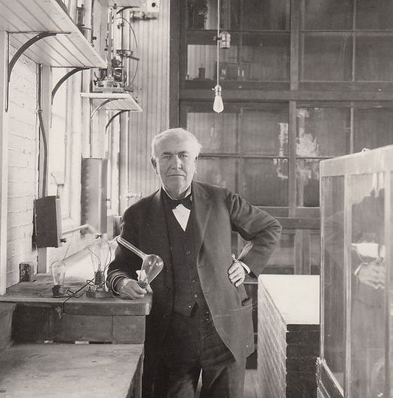
The Edisonian Approach
“I have not failed. I've just found 10,000 ways that won't work.”
-Thomas Edison [1]
[1]
How can we design proteins more intelligently than Edison did lightbulbs?
[1] https://www.thomasedison.org/edison-quotes

Slide 3
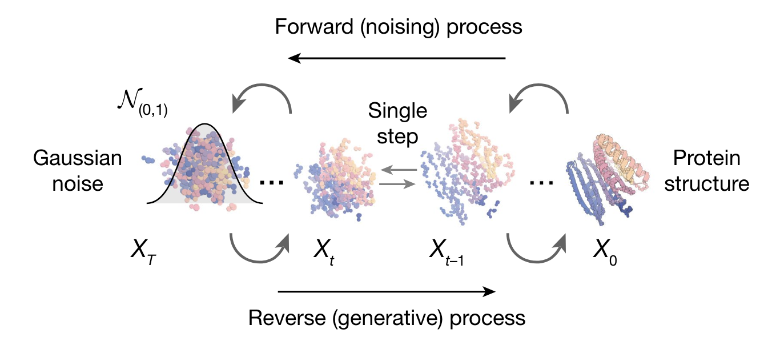
RFdiffusion
Generate Protein structures from a specified target
Workflow:
Rfdiffusion → Generate backbone structure
ProteinMPNN → Determine AA sequence
Alphafold → Verify structure folds correctly
Diffusion Models were previously used for image enhancement and generation
AA Sequence
Traditional Design
Inverse Design
Folded Structure
Interactions with other molecules
[2]
[2] Watson, J. L., Juergens, D., Bennett, N. R., Trippe, B. L., Yim, J., Eisenach, H. E., Ahern, W., Borst, A. J., Ragotte, R. J., Milles, L. F., Wicky, B. I. M., Hanikel, N., Pellock, S. J., Courbet, A., Sheffler, W., Wang, J., Venkatesh, P., Sappington, I., Torres, S. V., … Baker, D. (2023). De novo design of protein structure and function with RFdiffusion. Nature, 620(7976), 1089–1100. https://doi.org/10.1038/s41586-023-06415-8

Slide 4
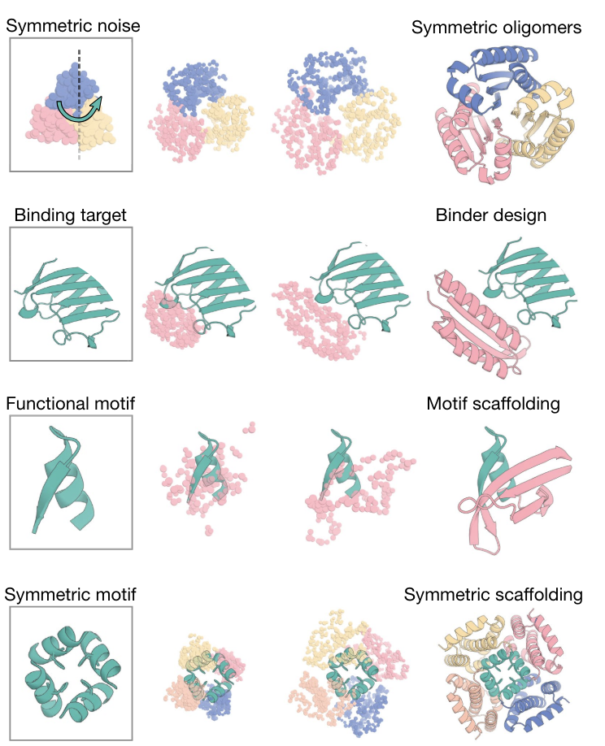
Rfdiffusion (contd)
Generate a set of unrelated structures
If we start with random noise, how do we design anything purposefully?
Give the model a variety of inputs
Sort of like providing an image that is partially blurry
[2]
[2] Watson, J. L., Juergens, D., Bennett, N. R., Trippe, B. L., Yim, J., Eisenach, H. E., Ahern, W., Borst, A. J., Ragotte, R. J., Milles, L. F., Wicky, B. I. M., Hanikel, N., Pellock, S. J., Courbet, A., Sheffler, W., Wang, J., Venkatesh, P., Sappington, I., Torres, S. V., … Baker, D. (2023). De novo design of protein structure and function with RFdiffusion. Nature, 620(7976), 1089–1100. https://doi.org/10.1038/s41586-023-06415-8

Slide 5
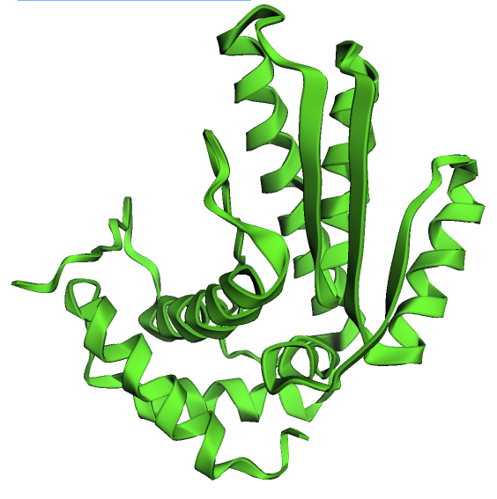
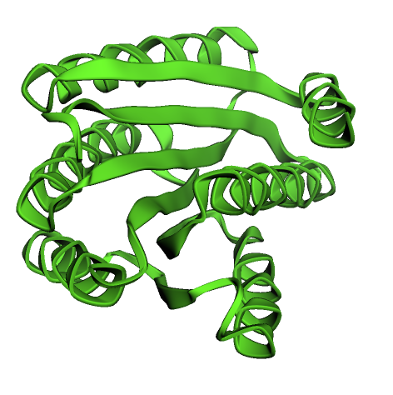
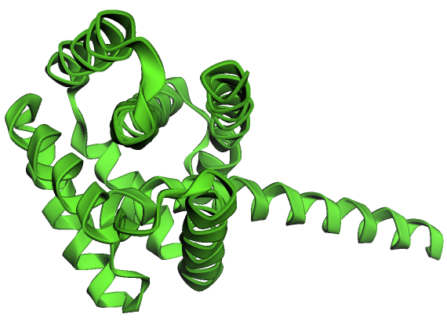
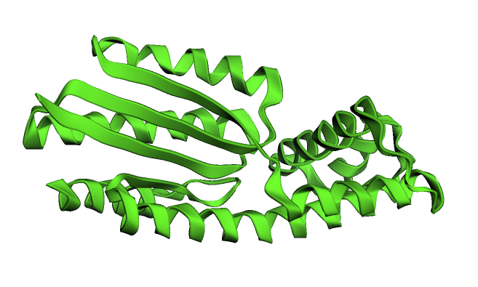
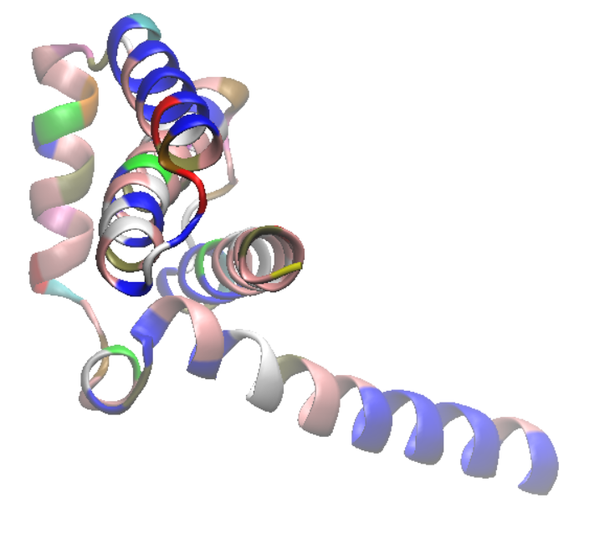
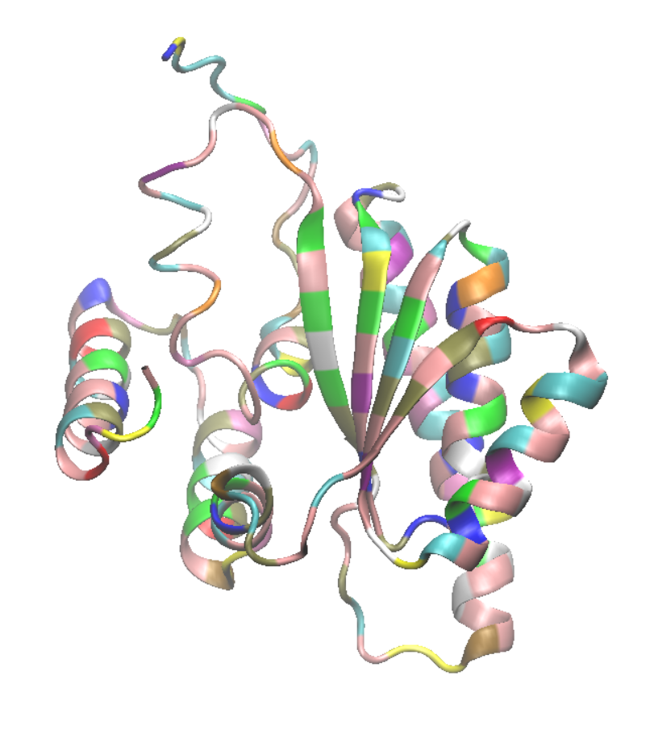
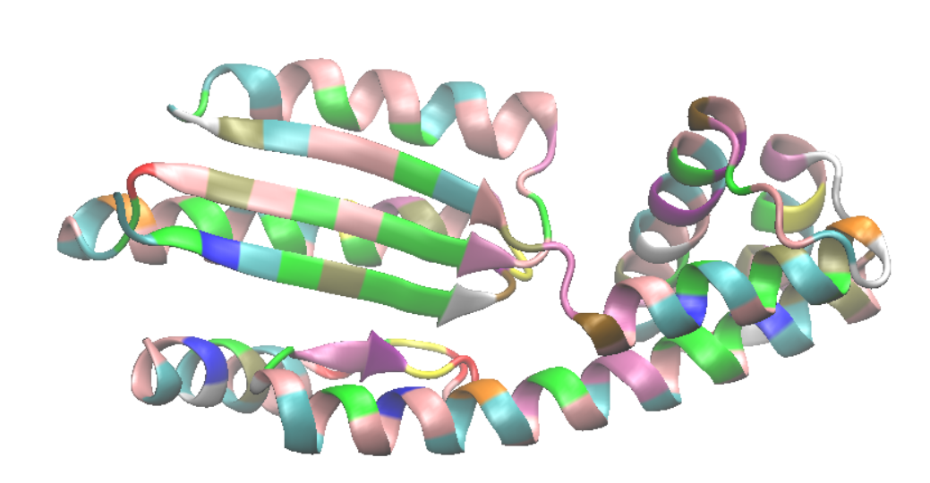
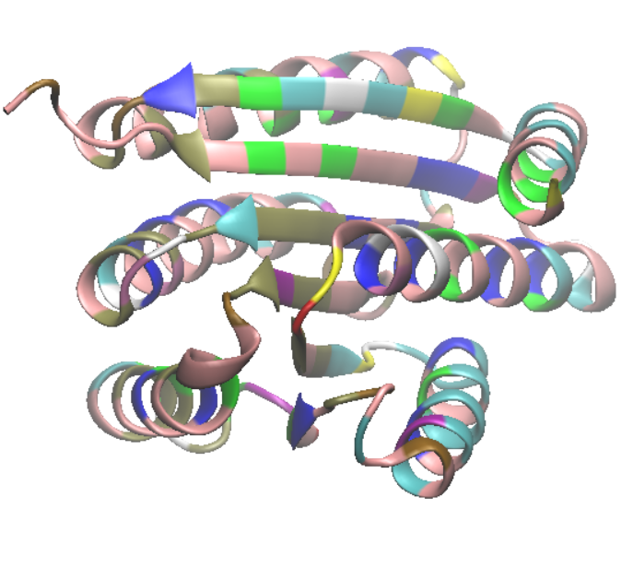
Let’s try it
Generating some unconditional monomers 200AA in length [3]:
From Rfdiffusion: backbone’s spatial arrangement, but left as pure glycine template
From ProteinMPNN and AF: AA Sequence and structure
RMSD:3.153
RMSD:8.432
RMSD:2.260
RMSD:1.518
Yup, those sure do look like proteins!
[3] https://colab.research.google.com/github/sokrypton/ColabDesign/blob/v1.1.1/rf/examples/diffusion.ipynb

Slide 6
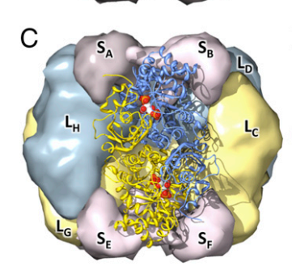
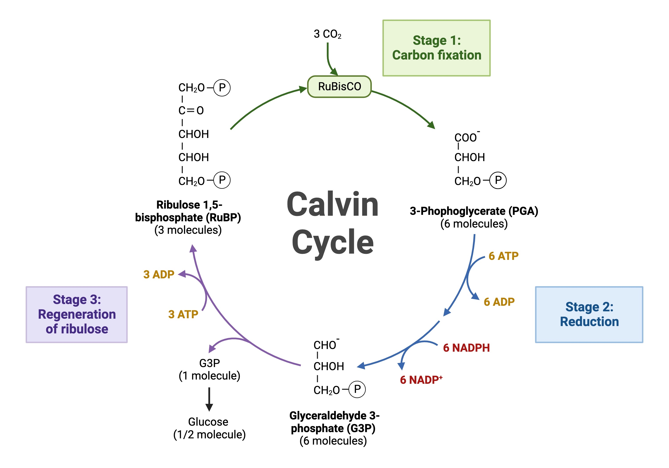
Rubisco
Earth’s most abundant protein and 30% of soluble protein in plants [4]
2 active sites are formed at the interface between 2 large subunits
Rubisco is slow and has poor selectivity
~30% energy is wasted to remove 2PG [5]
Evolution is stuck in a local minimum
Most mutations are destabilizing [4]
[4]
O₂
2-phosphoglycolate
(2PG)
[5]
[4] Studer, R. A., Christin, P. A., Williams, M. A., & Orengo, C. A. (2014). Stability-activity tradeoffs constrain the adaptive evolution of RubisCO. Proceedings of the National Academy of Sciences of the United States of America, 111(6), 2223–2228. https://doi.org/10.1073/pnas.1310811111
[5] Erb, T. J., & Zarzycki, J. (2018). A short history of RubisCO: the rise and fall (?) of Nature’s predominant CO2 fixing enzyme. Current Opinion in Biotechnology, 49, 100–107. https://doi.org/10.1016/j.copbio.2017.07.017
[6] https://slcc.pressbooks.pub/collegebiology1/chapter/the-calvin-cycle/ (modified)
[6]

Slide 7
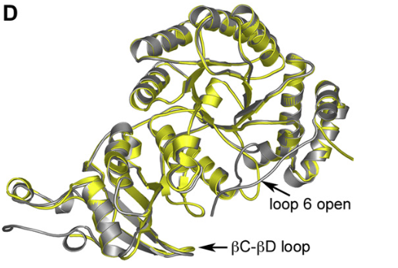
Improving rubisco
Carboxy terminus closes over the active site to allow the reaction to occur
“…the disruption of the contacts of residue 473 (with Arg134 and His310) in the mutant enzymes causes destabilisation of the under-lying loop 6.” [7]
Design a binder that connects to loop 6 (134), the carboxy terminal (473), then back to loop 6 (310)
Input to Rfdiffusion:
./RFdiffusion/run_inference.py inference.output_prefix=outputs/test inference.num_designs=4 inference.input_pdb=outputs/test/rubisco.pdb diffuser.T=50
'contigmap.contigs=[5-15/A133-135/5-15/A472-474/5-15/A309-311/5-15]’
inference.dump_pdb=True inference.dump_pdb_path='/dev/shm'
rbcL from spinach (gray) and rbcL from Halothiobacillus neapolitanus (sulfur oxidizing chemoautotroph) [7]
[7] Andersson, I., & Backlund, A. (2008). Structure and function of Rubisco. Plant Physiology and Biochemistry, 46(3), 275–291. https://doi.org/10.1016/j.plaphy.2008.01.001
[8] https://www.rcsb.org/structure/5iu0

Slide 8
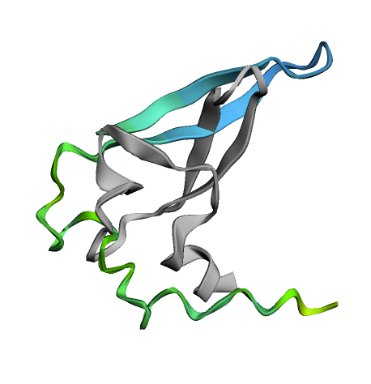
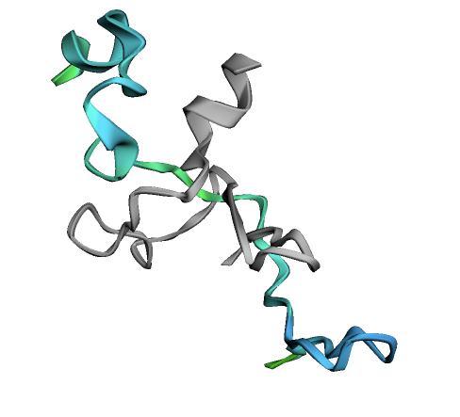
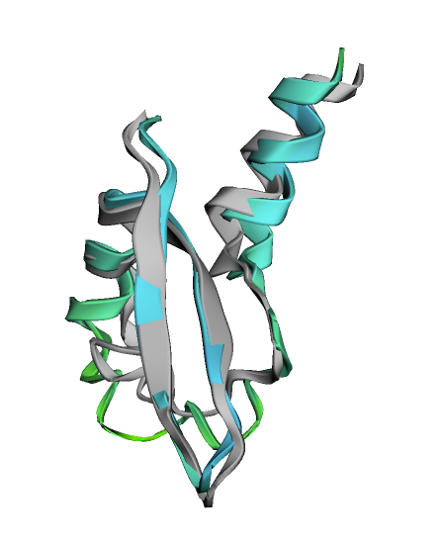
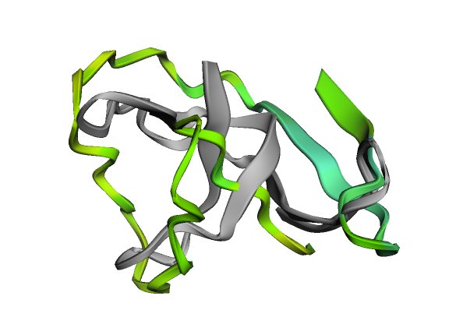
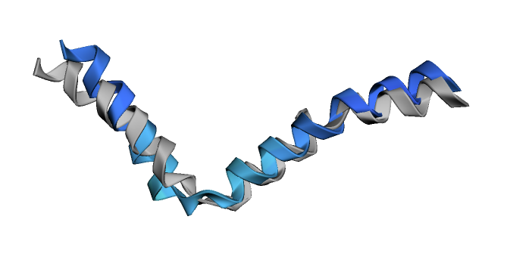
Improving Rubisco
Same workflow as before, but with Rubisco to guide generation
AF matches to RFdiffusion more poorly than unconditional generation
2
1
3
0
RMSD: 10.8
RMSD: 9.9
RMSD: 11.2
RMSD: 6.0
'contigmap.contigs=[5-15/A133-135/5-15/A472-474/5-15/A309-311/5-15]’
No direct indication of catalytic activity, but these could be interesting prototypes for further calculations
'contigmap.contigs=[5-15/A134-134/5-15/A473-473/5-15/A310-310/5-15]’
RMSD: 2.8

Slide 9
Conclusions
Rfdiffusion is a step towards inverse design of proteins
Coupled with ProteinMPNN, structures accurately match those predicted by AlphaFold
Generated several binders to interact near the active site of Rubisco
Further computation and experiments required to fully determine their effects!
Nevertheless an example of what Rfdiffusion is capable of
An interesting way to study Rubisco in silico
Expert guidance can be incorporated to refine Rfdiffusion
[2]
[4]

